Slide 1
Receipt & Invoice Digitizer
By: Shivangi Bhargava

Slide 2
Problem Statement Overview
Businesses and individuals handle numerous paper receipts and invoices, which are prone to loss, errors, and manual entry delays.
We built automated system for scanning, extracting and digitizing information from receipts and invoices using OCR.

Slide 3
Core Components
Frontend: Uses Streamlit to create a web-based dashboard with tabs for uploading receipts and viewing analytics.
API: Leverages Google Gemini Flash, a fast AI model that reads images and extracts itemised details into JSON.
Database: A SQLite database acts as a persistent vault, storing merchant names, dates, and costs indefinitely.

Slide 4
Database Structure
Uses sqlite3 to create a table called receipts.
It stores:
▪Merchant Name & Date of Purchase
▪Total Cost & Currency Type
▪Raw JSON: A detailed list of every item bought.
This allows the app to remember your spending even after you close the browser

Slide 5
Image Preprocessing
We used following to "clean" the receipt:
Grayscale: Removes unnecessary colors.
Denoising: Clears graininess.
Thresholding: Makes text black and white.
This results in much higher extraction success rates.

Slide 6
AI Extraction: Gemini API
The core intelligence is the analyze_receipt() function.
It sends the cleaned image to Google's AI with a specific prompt.
The AI is instructed to "Extract receipt details into JSON."
By specifying a format, we ensure the computer can read the AI's response without errors

Slide 7
Instructing the AI
We use a structured text prompt to tell the AI exactly what we want. This prevents the AI from "chatting" and forces it to just give us the data. Strict Output: The prompt ends with "Return ONLY JSON.”
JSON is like a digital checklist. It defines labels like "merchant" and "total". This makes it easy for our Python code to save the data directly into our SQLite database.

Slide 8
User Interface
Multi-Format Upload: Supports JPG, PNG, and even multi-page PDFs.
Side-by-Side View: Users see the original image vs the "cleaned" AI version.
History Vault: A persistent table that lets users select a specific receipt to see its individual line items.
Analytics dashboard: Includes filters, charts and graph.

Slide 9
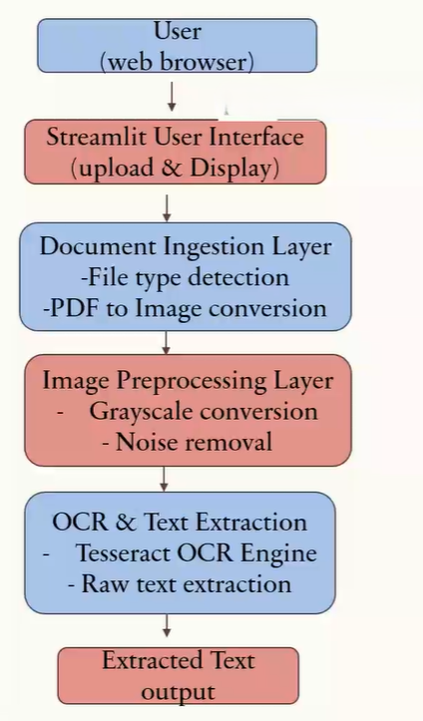
System Architecture Diagram

Slide 10
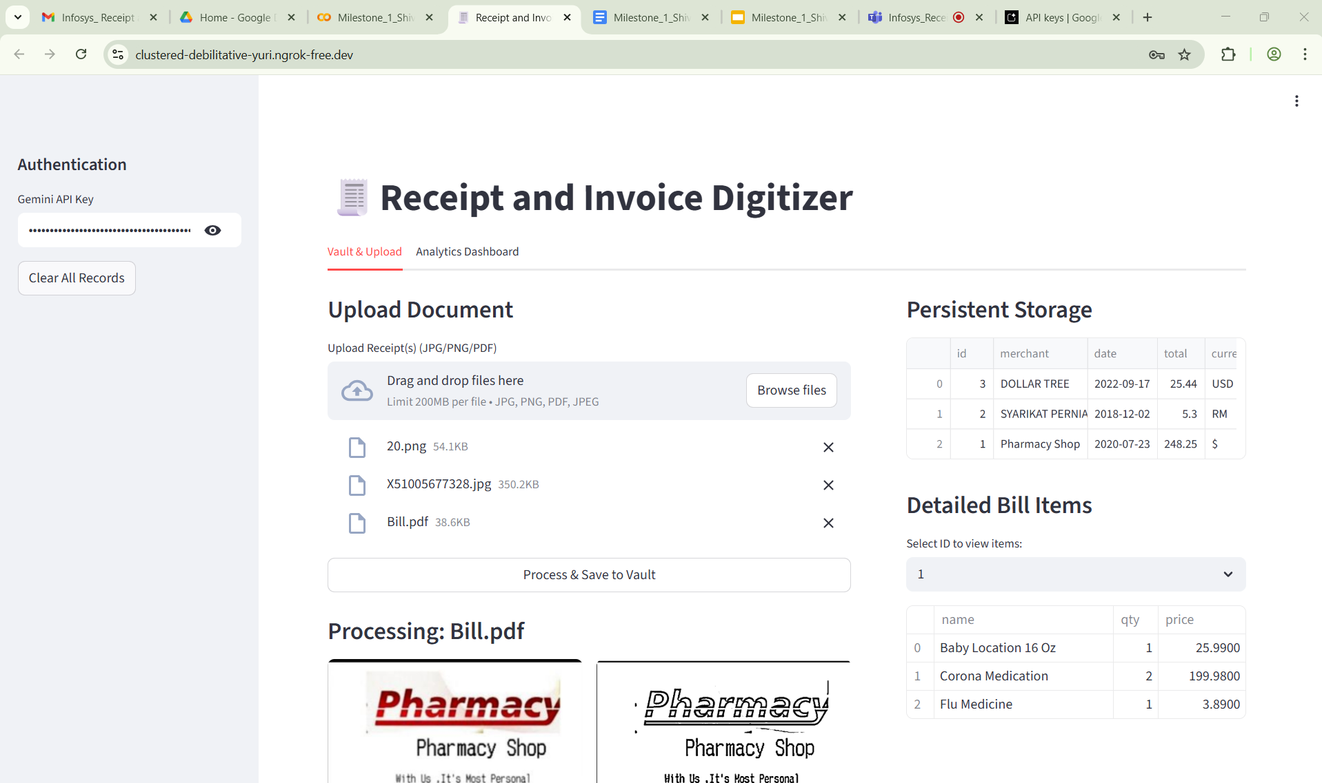
Screenshots

Slide 11
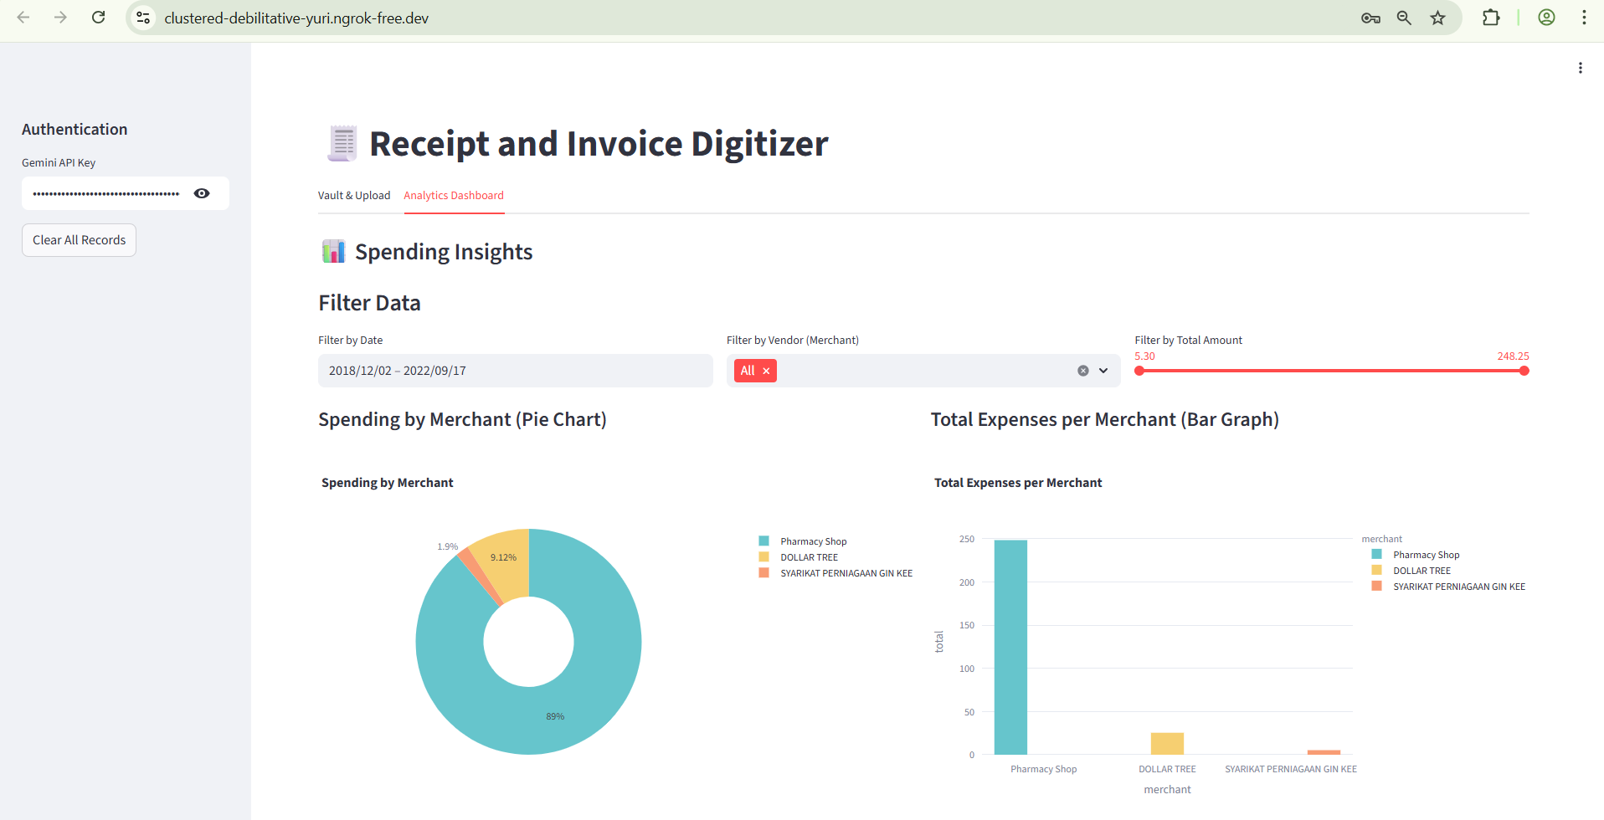
Screenshots

Slide 12
Implemented Modules
Milestone 1:
Document Ingestion & OCR
Implement file upload.
Preprocess images for OCR.
Extract raw text from sample receipts.

Slide 13

Milestone 2 - Implemented Modules
• Apply regex + NLP to parse key fields.
• Validate totals and detect duplicates.
• Store structured results in DB.

Slide 14

Field Extraction & Validation
• NLP/Regex-based extraction for date, vendor, invoice ID, tax, total amount, line items.
• Validate extracted totals (subtotal + tax = total).
• Detect duplicates via invoice number or hash.

Slide 15
Field Extraction & Validation
Incorporated following modules or features into the code :
NLP/Regex-based Extraction: The analyze_receipt function uses the Gemini model, which is an NLP-based model, to extract 'merchant', 'date', 'total', 'currency', 'invoice_id', 'tax', and 'items' from the receipt image. The prompt is designed for the structured JSON extraction.
Validate Extracted Totals: The validate_extracted_total function is implemented and used within the 'Validation' tab to check if the calculated subtotal plus extracted tax approximately equals the extracted total. This provides a crucial validation layer.
Duplicate Detection: Duplicate detection is handled in the save_to_db function using a SHA-256 file_hash of the image. Additionally, there's a fallback duplicate check based on 'merchant', 'date', 'total', and 'invoice_id'. The 'Validation' tab also displays the duplicate status for selected receipts.

Slide 16

Database Storage
• Store structured invoice/receipt data in SQL database.
• Support search by vendor, date, or amount.

Slide 17
Database Storage
Store Structured Data in SQL Database: The init_db function sets up an SQLite database, and save_to_db is responsible for storing the extracted and structured receipt data (including merchant, date, total, currency, invoice_id, tax, raw_json, file_hash, and timestamp) into the receipts table.
Support Search by Vendor, Date, or Amount: The 'Analytics Dashboard' tab includes interactive filters that allow users to search and filter receipts by 'Date' range, 'Vendor' (Merchant), and 'Total Amount'. This provides search functionality which makes analytics visually appealing and dynamic.

Slide 18
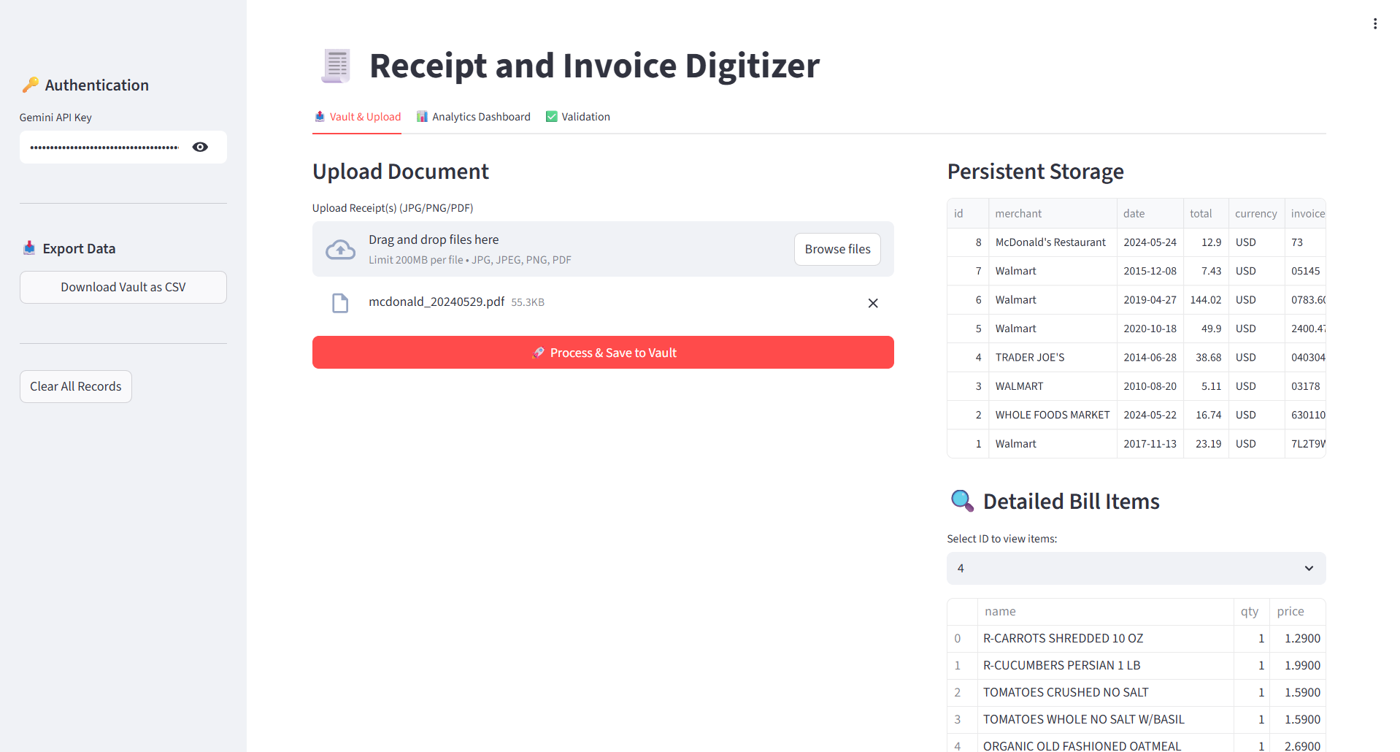
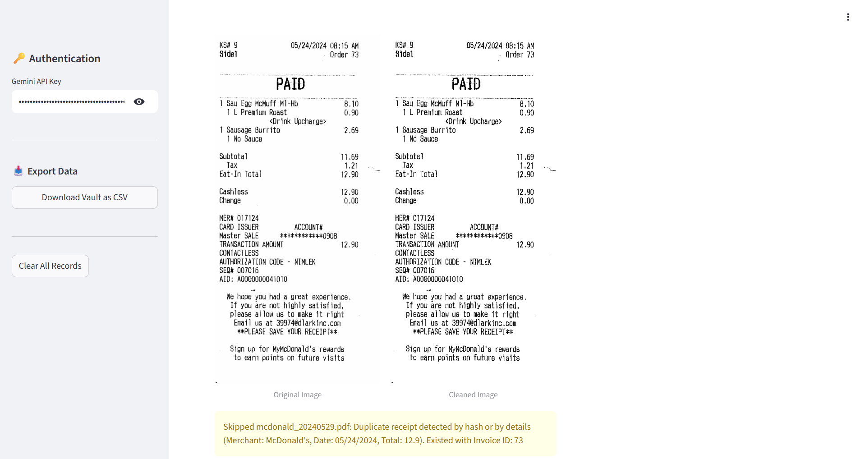
Screenshot : Tab 1

Slide 19
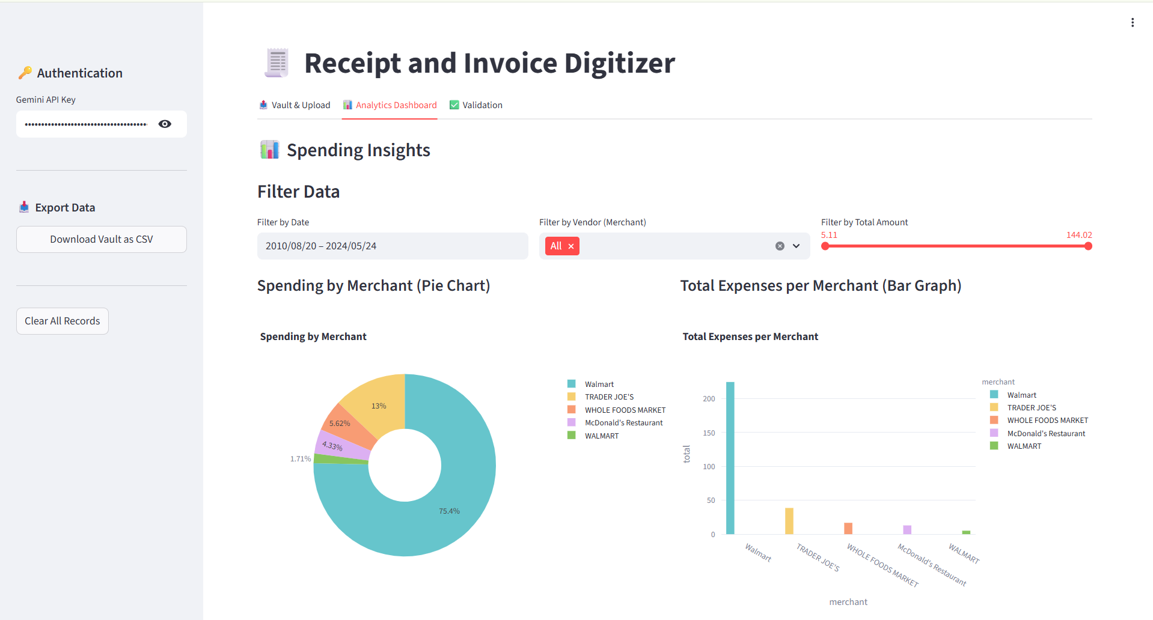
Screenshot : Tab 2

Slide 20
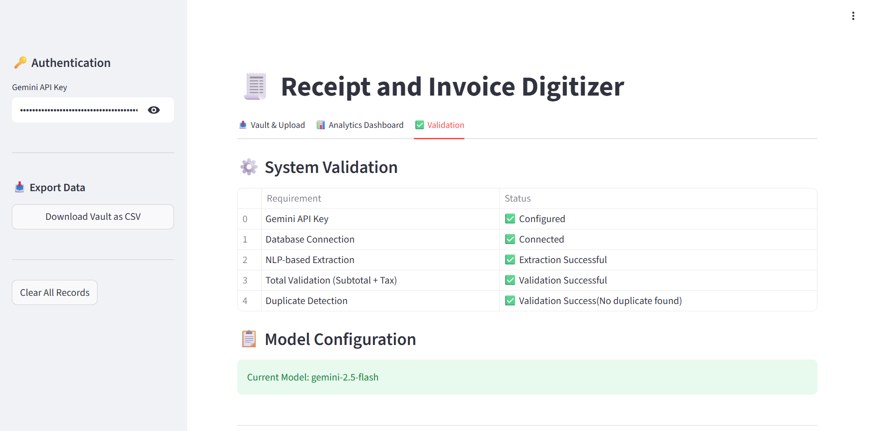
Screenshot : Tab 3

